Slide 1
Letter Components and Layout

Slide 2
Components of a letter
Letter Head
Date
Inside Address
Subject Statement (Optional)
Attention Line (Optional)
Salutation
The Body of the letter
Complimentary Close
Writer’s signed and typed names
Reference initials (Optional)
Enclosures (Optional)
Copy notation (Optional)
Postscript (Optional)

Slide 3
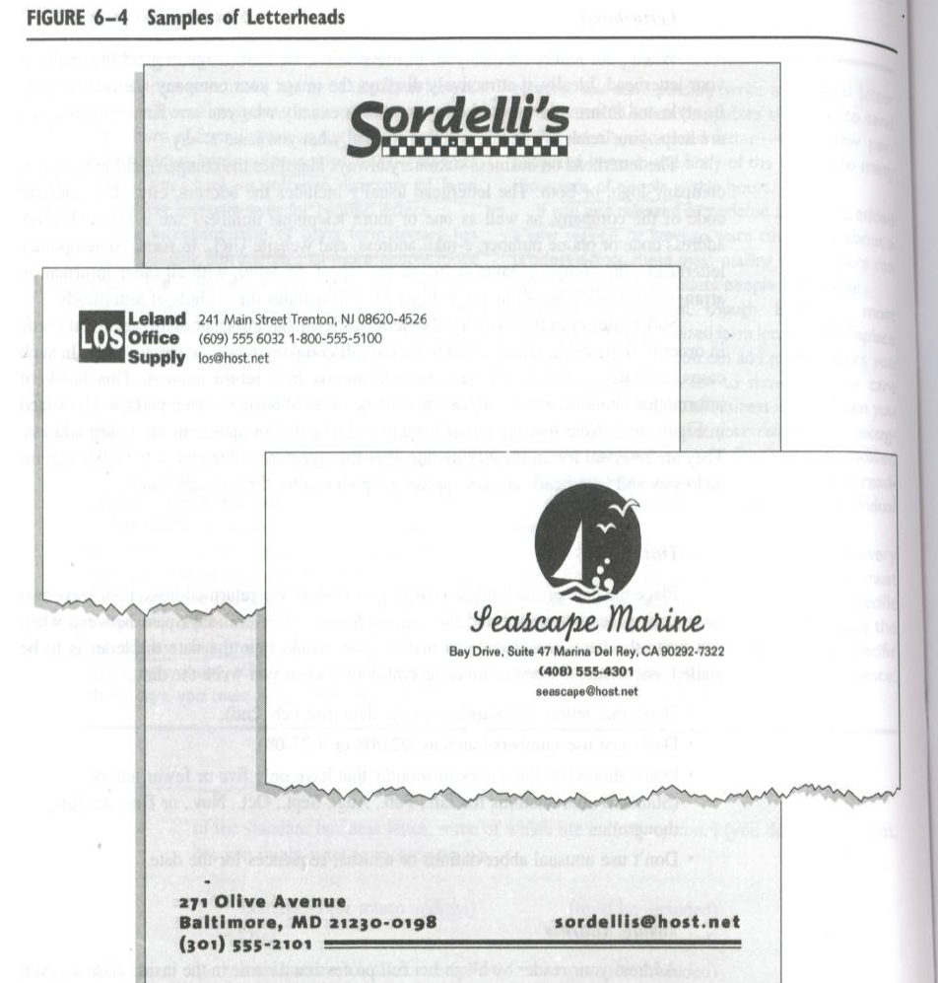

Slide 4
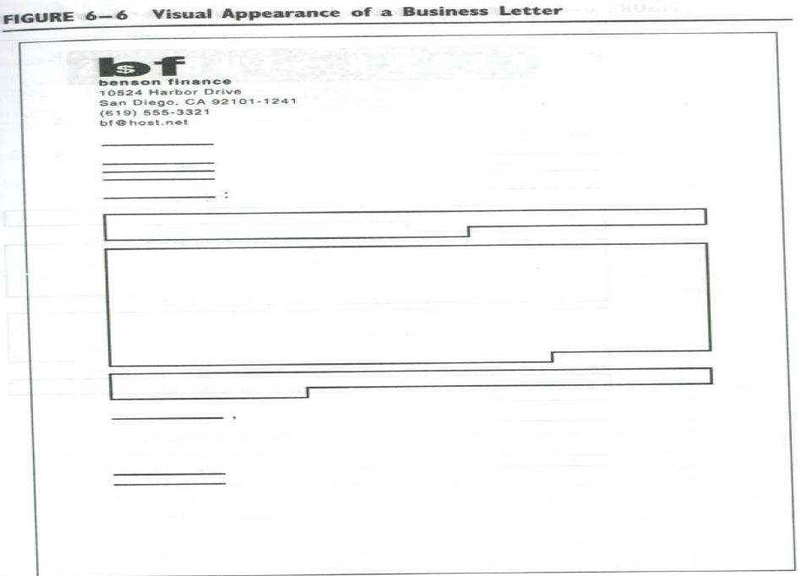

Slide 5
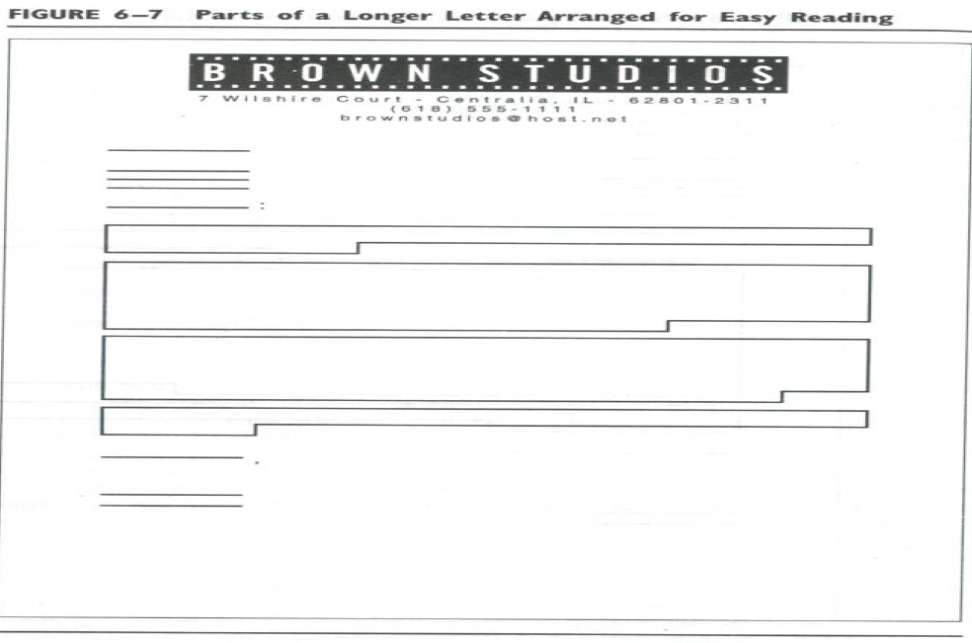

Slide 6
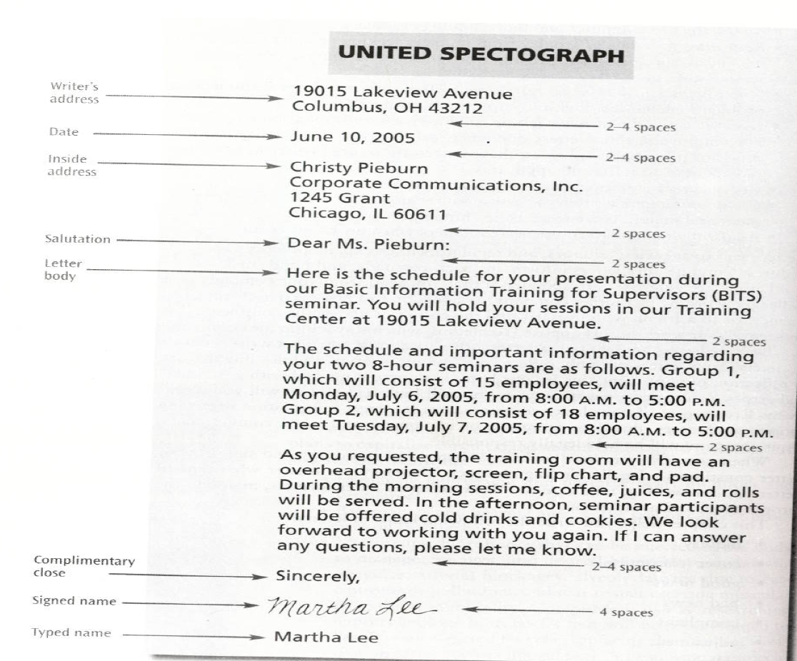

Slide 7
Letter- Formats
Full-Block Format
Modified Block Format
Simplified Format
Indented Format

Slide 8
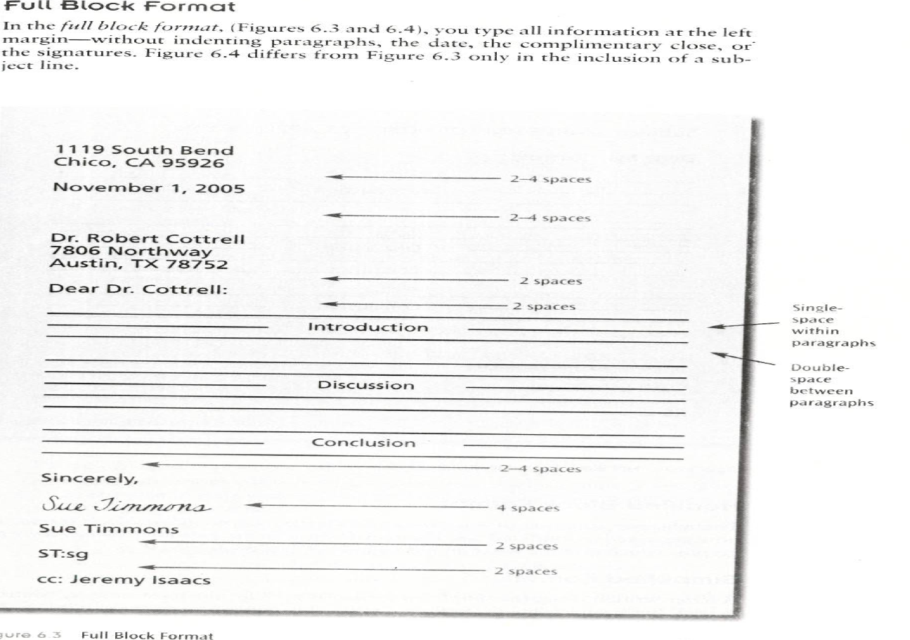

Slide 9
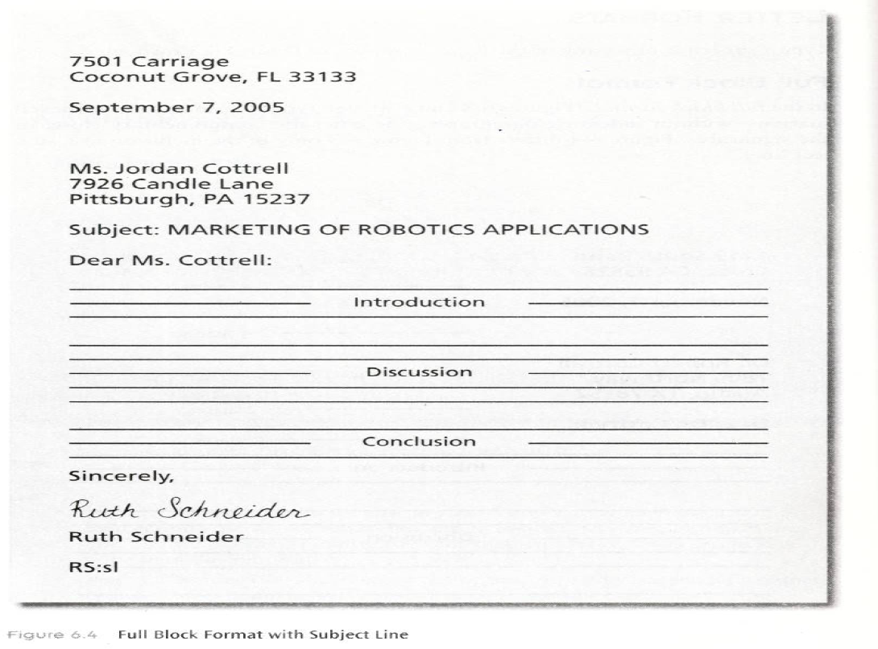

Slide 10
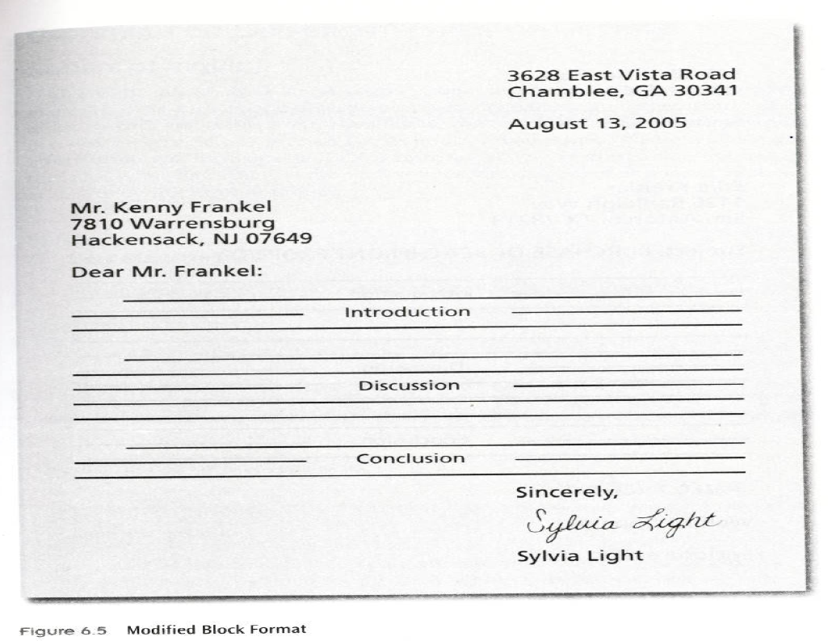

Slide 11
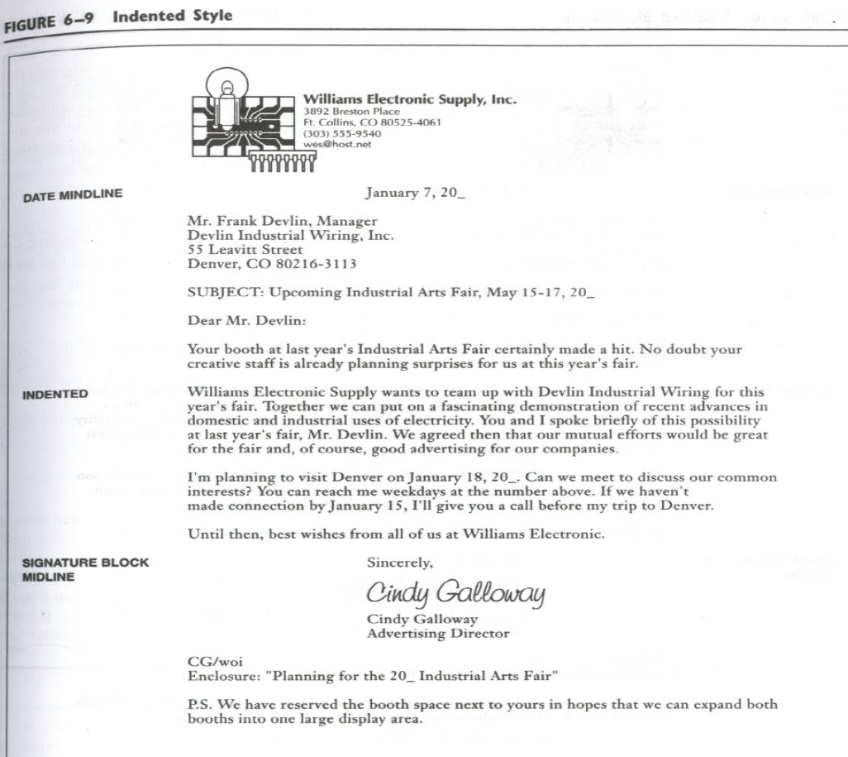

Slide 12
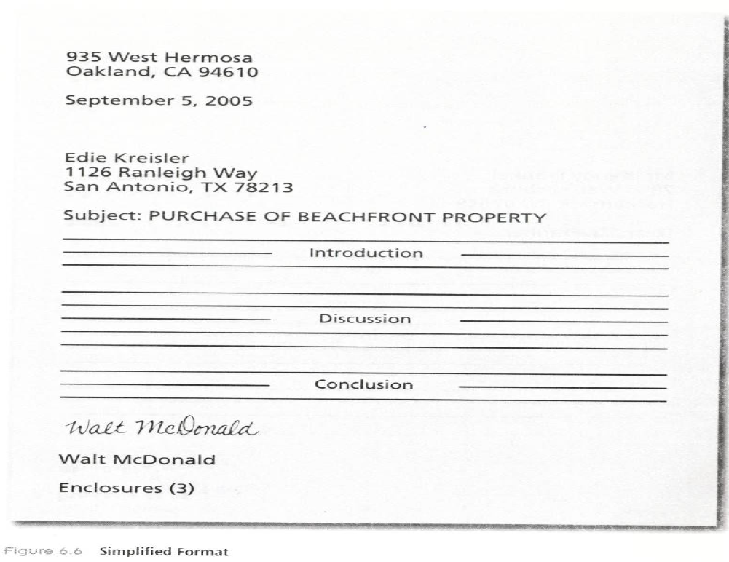

Slide 13
The six C’s of Business Letter Writing
Complete
Coherent
Concise
Concrete
Convincing
Considerate

Slide 14
Reader’s point of View(Tone of the letter)
Also known as ‘You-attitude’.(Place the reader first, reader’s interest, desires and needs).
Select an appropriate tone (persuasive, pleasant, requesting, apologetic, conciliatory, friendly, firm and so on) In business letters, try to sound helpful and friendly.
Keep to the point
Write a strong opening
Write a strong close

Slide 15
Emphasizing You more than I
I Emphasis – I am sending information on peripheral devices suited to the computer I sold you.
You Emphasis – You’ll receive complete instructions with details on capabilities and prices of optional add-ons suited to your new computer.

Slide 16
…Some Examples
We wish to point out… (You will be interested to know…)
We wish to announce…(You will be glad to hear…)
We are enclosing our…(You will find your cheque enclosed…)
When we receive..(When you send…)
This book is designed to help its readers plan a better vacation. (…you…)

Slide 17
Showing a Warm, friendly Tone
1. Focus on people more than on things.
2. Include feelings as well as facts

Slide 18
Focus on People more than on things
Version 1- ‘Alternatives in pension Planning’ presents four popular pension plans, each with advantages and disadvantages. The report evaluates the plans in relation to specific company needs. The report is clear and ready.
Version 2- Thank you, Sujata, for your good work in ‘Alternatives in Pension Planning.’ You’ve analyzed the four competing plans in a clear, orderly way – just what we need to help us choose the best plan for our company.

Slide 19
Showing a warm friendly tone
Not- We will meet at 3 P.M.
Instead – I look forward to talking with you at our 3 P.M. meeting.

Slide 20
Opening the Letter
Avoid Obvious Opening Statements
E.g.- I have before me your letter of the 10th in which you asked me for a letter of reference concerning Mr. Gupta who is applying for the position of General Manager for your company.
Instead write: It is a pleasure to recommend Mr. Gupta for the position of General Manager of your company.

Slide 21
The manager writes: ‘The Everest Peak project shows some promise’.
The reader interprets: ‘The project sounds tentative, iffy.’
The manager writes: ‘You’ll probably share my excitement about the potential of the Everest Peak project.’
The reader interprets: ‘Excited? There’s something worth looking into here.’

Slide 22
Avoid :
Trite Expressions:
We wish to take this opportunity to thank you…
This letter is a response to your enquiry of…
We have received your recent correspondence and have given it due consideration…
This will acknowledge receipt of…
Referring to our telephone conversation of…

Slide 23
Personal Pronoun
E.g.- We have your letter of August 27 and enclosed cheque
Instead write: Thank you for the cheque of Rs 15000/- enclosed with your letter of Aug 27.

Slide 24
Strategies for writing the Body of a Letter
State the main Business, Purpose, or subject matter right away.
Keep the paragraphs short
Provide topic indicators in the beginning of Par-
agraphs.
Place important information strategically
Focus on the Recipient’s Needs, purpose, or interests instead of your own.
Give an action ending whenever appropriate

Slide 25
Closing the Letter
Either to induce favourable action or to make a favourable impression on the reader
We look forward to hearing from you soon
Thanking you for your interest
Hoping to hear from you soon

Slide 26
Letter Wizards and Templates
Letter Templates – In MS word, click on ‘File’ and ‘New’ to get 3 types of letter templates.
Letter Wizard
Step 1 – Letter Format
Step 2 – Recipient Info (Name, Add, Salutation
Other Elements – (reference line,mailing instructions, an attention line, a subject line, and courtesy copies
Sender Info – Sender’s name, return add, select from 13 complimentary closes including take care, best wishes, love, then click on ‘Finish’.

Slide 27
Read the following postscript to a business letter addressed to a prospective client. Evaluate in writing the effect such a P.S. may have on its reader.
P.S. I forgot to mention the third advantage of our RiDex office systems: a 24-month guarantee, including repair labor or replacement. Sorry.

Slide 28
Write an appropriate subject line for each of these situations
A. A letter informing the reader that his life insurance policy #29832 will expire soon, due to nonpayment of premium.
B. A letter to a bank suggesting that a separate deposit window be opened for merchants from 3 P.M. to 5 P.M/ each workday.
C. A letter to the company personnel director, requesting information on resource and referral programs for employees’ elderly relatives.

